Slide 1



Desafio_Projeto_Data Analytics
View in Power BI
Last data refresh:
08/02/2026 17:35:49 UTC
Downloaded at:
08/02/2026 17:37:55 UTC

Slide 2

Home Page
Notes:
image
No alt text provided

Slide 3
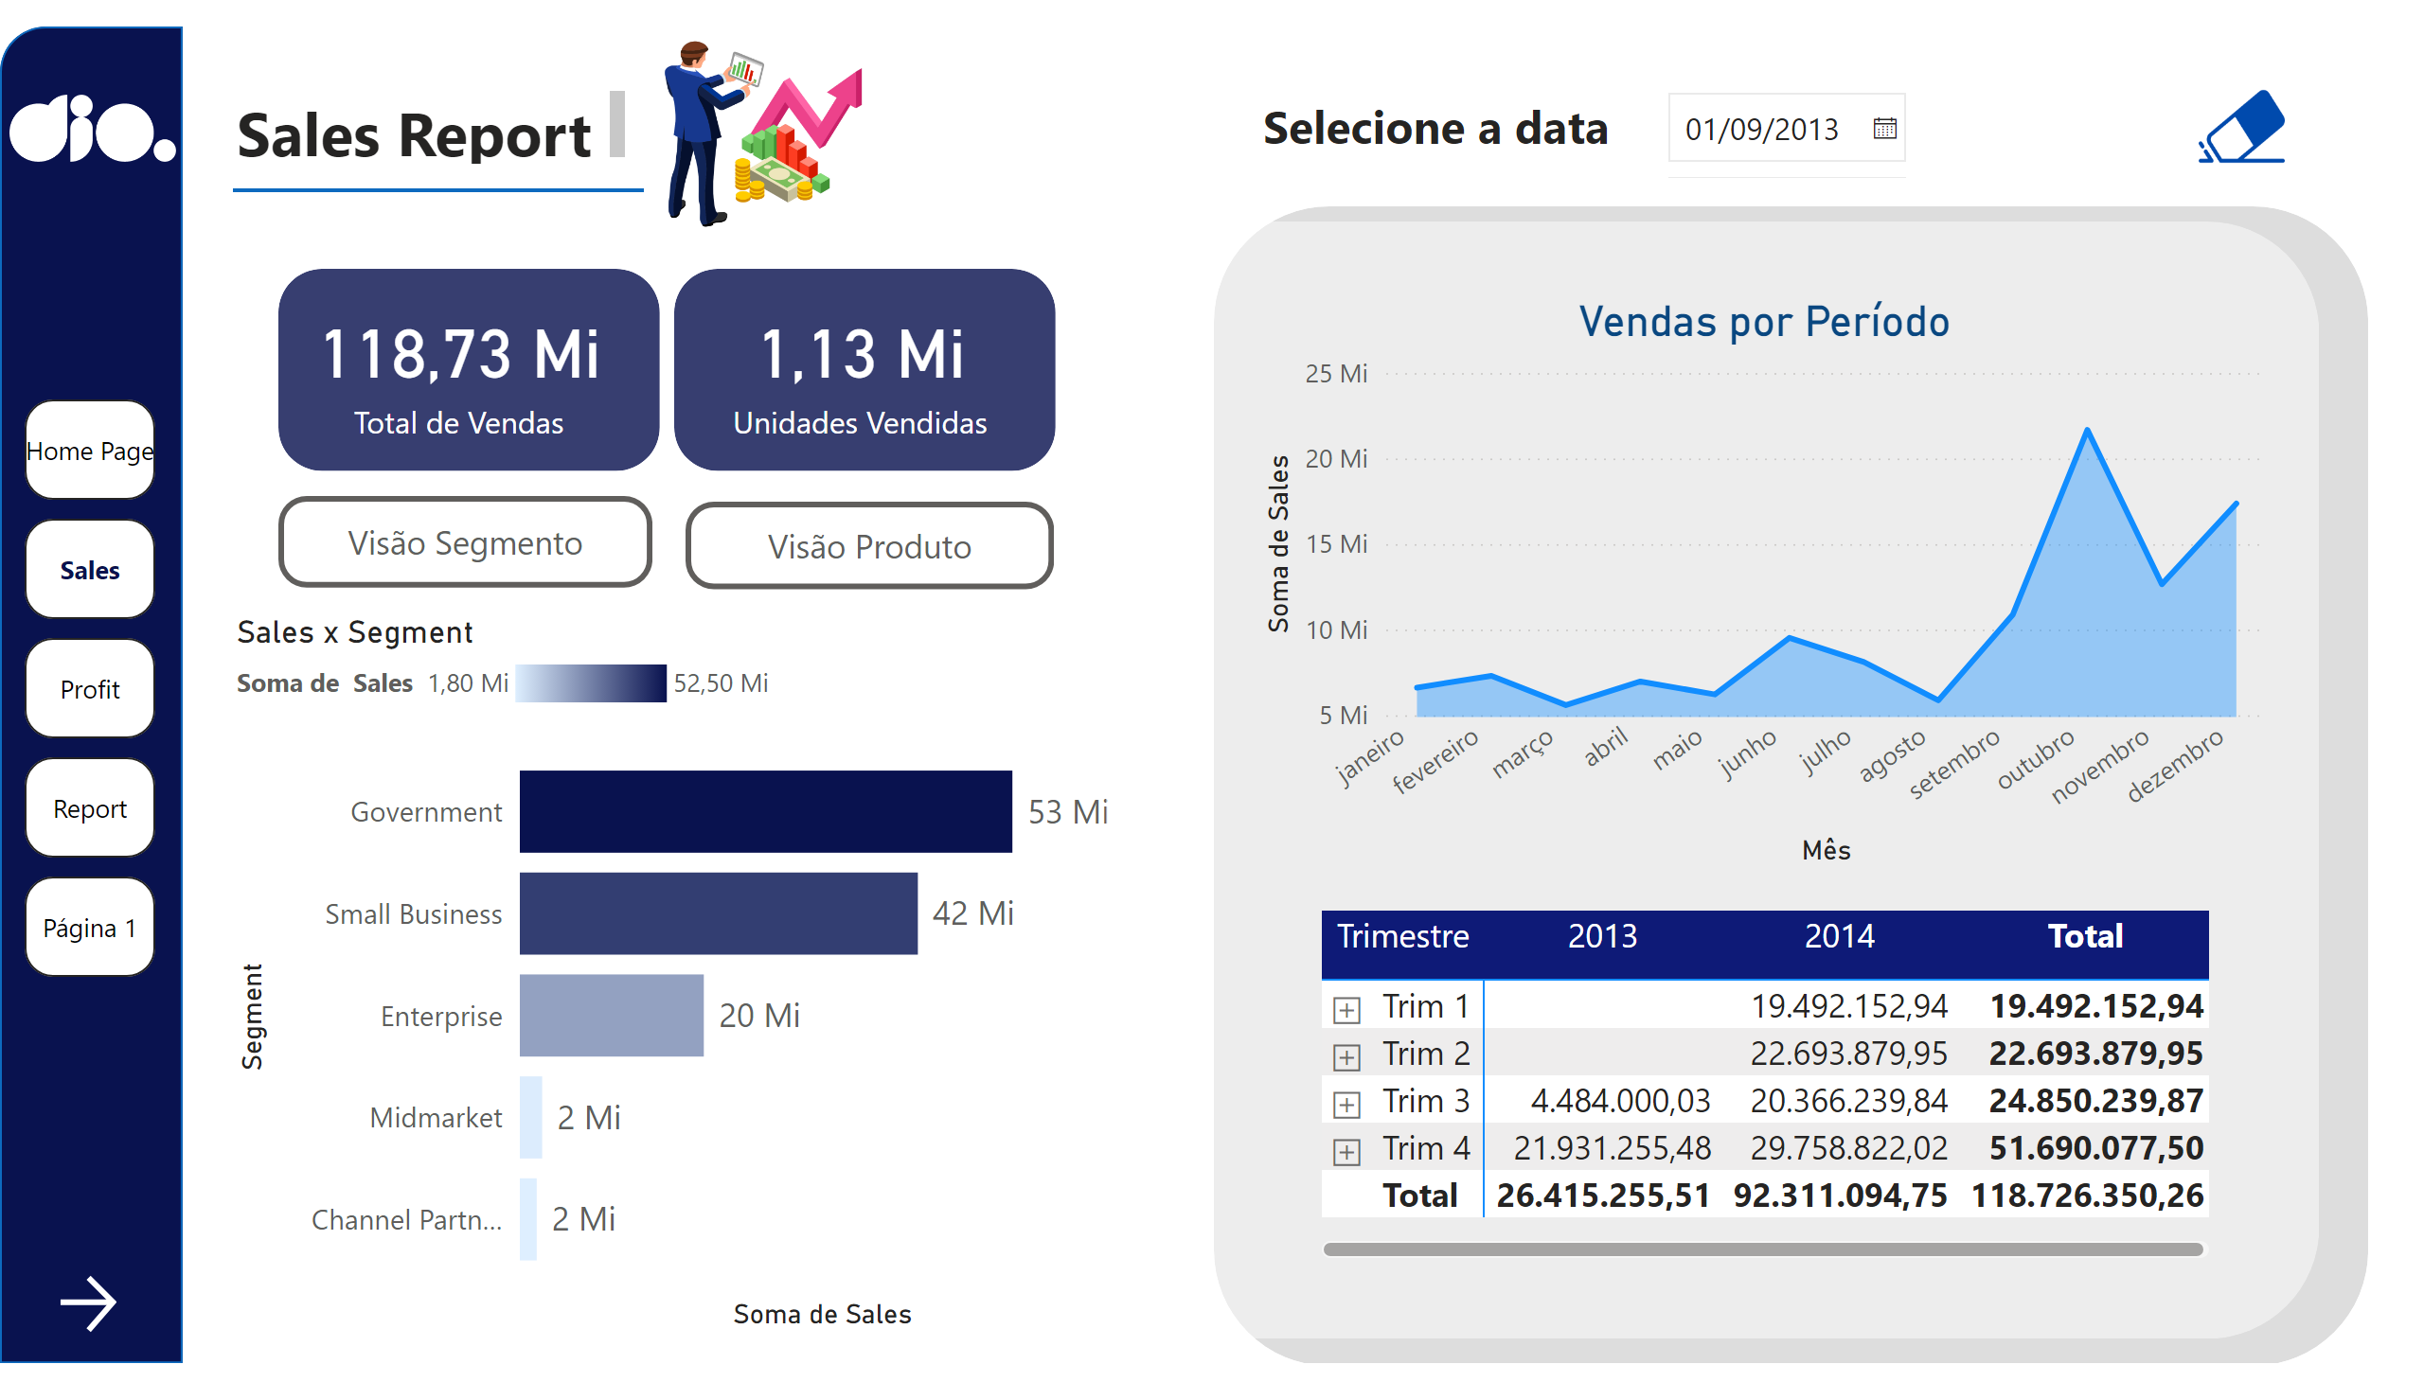
Sales
Notes:
logo_dio
No alt text provided
shape
No alt text provided
image
No alt text provided
card
No alt text provided
card
No alt text provided
shape
No alt text provided
shape
No alt text provided
textbox
No alt text provided
shape
No alt text provided
B-Segmento
No alt text provided
B-Produto
No alt text provided
Sales x Segment
No alt text provided
clusteredBarChart
No alt text provided
Vendas por Período
No alt text provided
clean
No alt text provided
actionButton
No alt text provided
textbox
No alt text provided
slicer
No alt text provided
Botão - Next
No alt text provided
pivotTable
No alt text provided
shape
No alt text provided
shape
No alt text provided
pageNavigator
No alt text provided

Slide 4
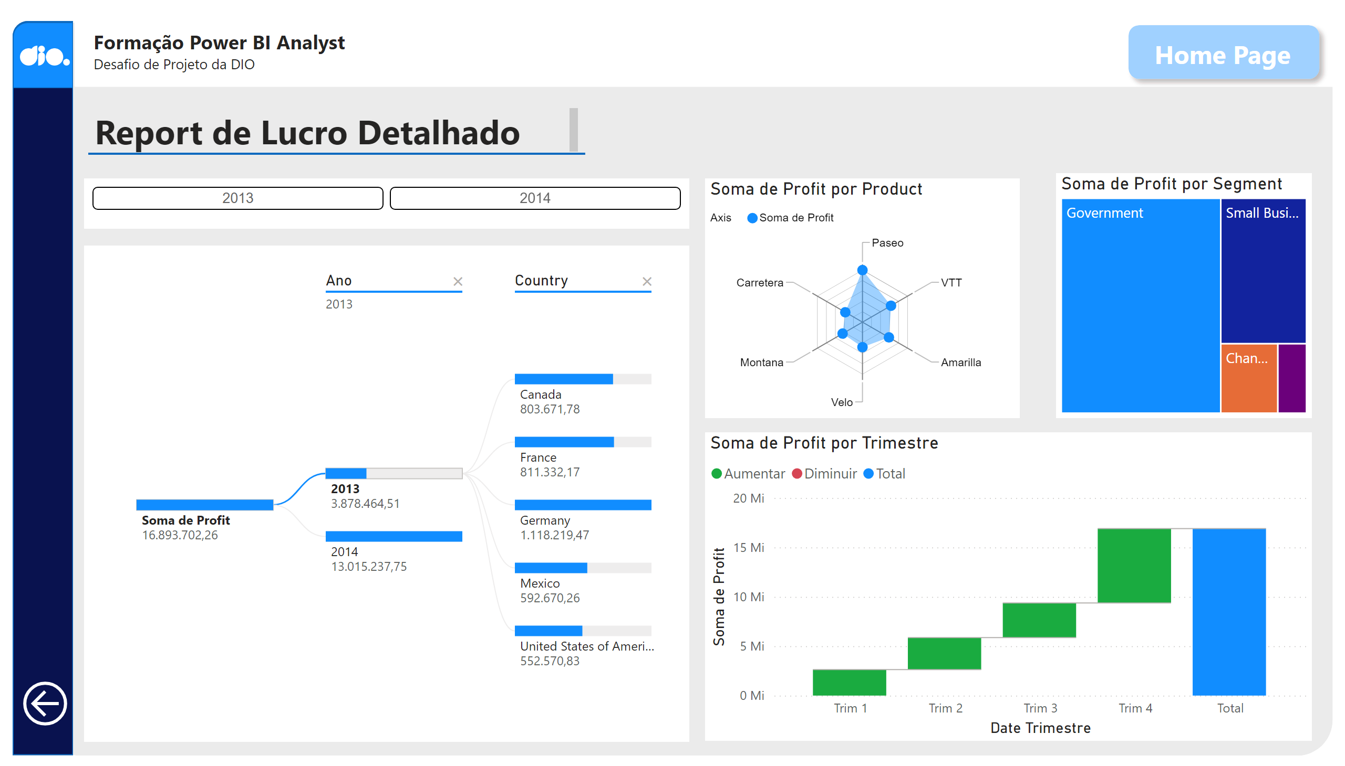
Profit
Notes:
shape
No alt text provided
shape
No alt text provided
shape
No alt text provided
image
No alt text provided
Fundo do Título
No alt text provided
Título do report
No alt text provided
shape
No alt text provided
decompositionTreeVisual
No alt text provided
waterfallChart
No alt text provided
ChicletSlicer1448559807354
No alt text provided
treemap
No alt text provided
textbox
No alt text provided
shape
No alt text provided
actionButton
No alt text provided
textbox
No alt text provided
Home Page
Home page
RadarChart1446119667547
No alt text provided

Slide 5
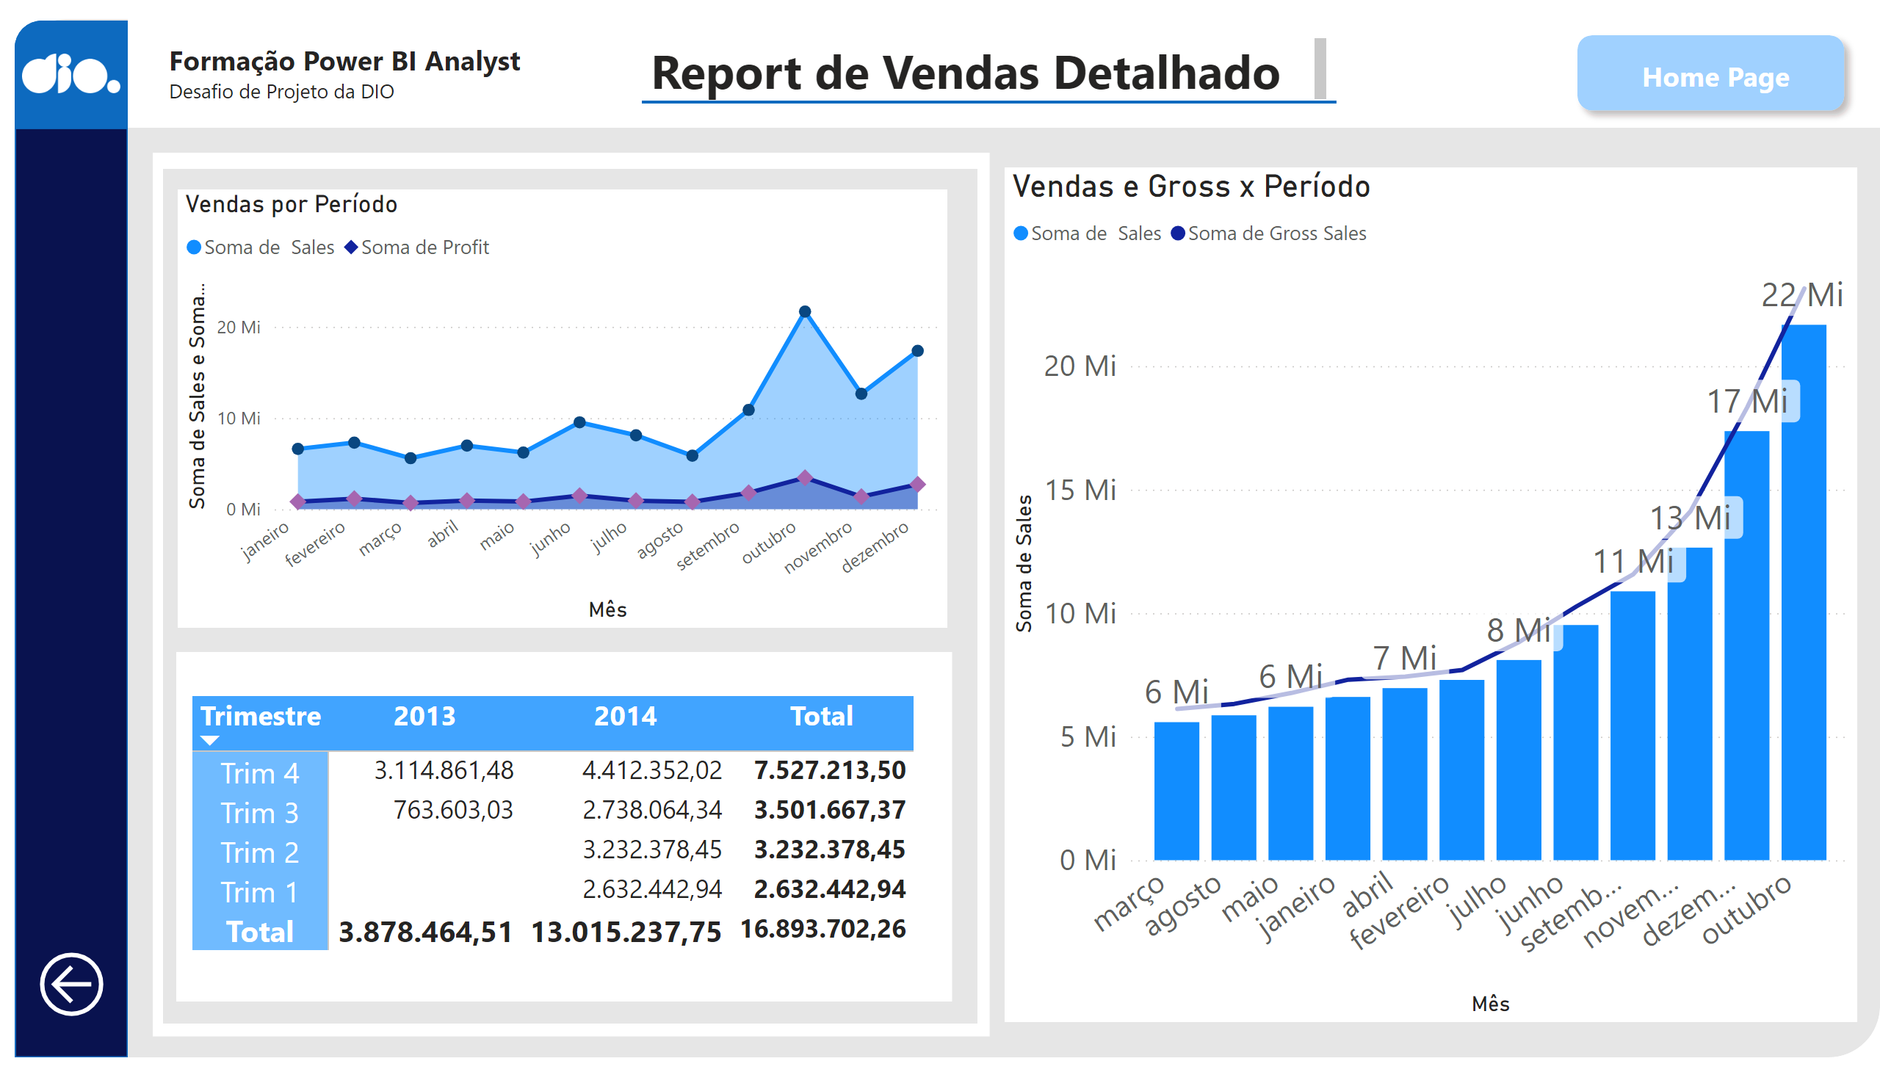
Report
Notes:
Vendas e Gross x Período
No alt text provided
shape
No alt text provided
logo_dio
No alt text provided
shape
No alt text provided
shape
No alt text provided
shape
No alt text provided
shape
No alt text provided
shape
No alt text provided
shape
No alt text provided
pivotTable
No alt text provided
Vendas por Período
No alt text provided
Título do report
No alt text provided
textbox
No alt text provided
shape
No alt text provided
shape
No alt text provided
actionButton
No alt text provided
textbox
No alt text provided
Home Page
Home page

Slide 6
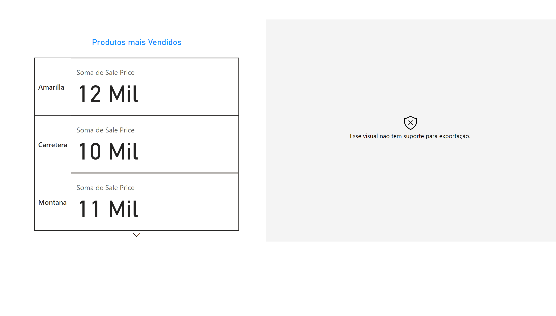
Página 1
Notes:
histogramF963F133BA02A0B35D286F09F80E9C78
No alt text provided
Produtos mais Vendidos
No alt text provided

